Slide 1
Sentinel for Terraform Workshop (v1)
Roger Berlind
Sr. Solutions Engineer
HashiCorp
Notes:
These slides are intended to accompany the Sentinel for Terraform v1 workshop
They should be used with the Sentinel for Terraform v1 Instruqt track:
https://instruqt.com/hashicorp/tracks/sentinel-for-terraform-v1

Slide 2
Agenda
Sentinel in Terraform Cloud (TFC) and Terraform Enterprise (TFE)
The Sentinel Language
Workshop Challenges: Using the Sentinel CLI and Running a Policy
Writing Sentinel Policies and Testing them with the Sentinel CLI
Workshop Challenge: Write Your First Policy
Using Sentinel in Terraform Cloud
Advanced Techniques
Workshop Challenges: Write More Policies
Notes:
In addition to learning about the topics in the agenda, you will be able to try your hand at writing and testing some Sentinel policies in a lab environment.
This presentation and the exercises are based on the Writing and Testing Sentinel Policies for Terraform guide: https://www.hashicorp.com/resources/writing-and-testing-sentinel-policies-for-terraform

Slide 3
Versions of this Workshop
There are two versions of the Sentinel for Terraform workshop:
This version, v1, uses the older v1 versions of the Terraform Sentinel imports tfplan, tfstate, and tfconfig, which can be used with both Terraform 0.11 and 0.12.
A newer version, v2, uses the newer v2 versions of those imports which can only be used with Terraform 0.12 and higher.
Use the v1 versions of the slides and Instruqt track if you are still using Terraform 0.11 or are not yet ready to adopt the new v2 imports.
Otherwise, use the v2 versions of the slides and Instruqt track.
Notes:
This v1 version of the presentation is Sentinel-for-Terraform-v1.pptx.
The v2 version of the slides is https://github.com/hashicorp/field-workshops-terraform/blob/master/docs/slides/multi-cloud/sentinel-for-terraform/Sentinel-for-Terraform-v2.pptx
The v1 version of the Instruqt track is https://play.instruqt.com/hashicorp/tracks/sentinel-for-terraform-v1
The v2 version of the Instruqt track is https://play.instruqt.com/hashicorp/tracks/sentinel-for-terraform-v2

Slide 4
Sentinel in Terraform Cloud and Terraform Enterprise
Notes:
Let's talk about Sentinel and how it fits into Terraform Cloud and Terraform Enterprise.
We'll also discuss how customers are using Sentinel in TFC and TFE.

Slide 5
What is Sentinel?
HashiCorp's Sentinel is a framework for implementing governance policies as code in the same way that Terraform implements infrastructure as code.
It includes its own language and is embedded in HashiCorp's enterprise products.
Using Sentinel ensures that your governance policies are actually being checked rather than just being listed in a spreadsheet.
It supports fine-grained policies that use conditional logic.
It includes a CLI that allows you to test and run policies.
Notes:
Sentinel is a framework for implementing governance policies as code
It has its own language
It has a CLI for testing and running policies

Slide 6
Terraform Cloud and Terraform Enterprise
Terraform Cloud (TFC) includes the following advanced functionality that makes it easier for teams and organizations to use Terraform:
A User Interface
Workspace Management
Team Management
State Management
Secure Variable Management
Remote Runs and State
VCS Integrations
HTTP/JSON API
Full Private Module Registry
Configuration Editor
Sentinel (policy as code)
SSO via SAML Integration
Audit Logging
Customers can install Terraform Enterprise (TFE) servers to self-host TFC in their own virtual private networks or in their data centers.
Notes:
Let's level set about Terraform Cloud and Terraform Enterprise

Slide 7
Where is Sentinel Used in Terraform?
Sentinel policies are checked between the standard plan and apply steps of Terraform runs.
Policies have different enforcement levels.
Violations prevent runs from being applied unless a user with sufficient authority overrides them.
Sentinel policies can evaluate the attributes of existing and new resources based on information associated with the current run:
the plan, the configuration, the current state, and other run data including cost estimates
This ensures that resources comply with all policies before they are provisioned.
Notes:
Let's talk about where Sentinel is used in TFC and TFE.

Slide 8
How Customers are Using Sentinel in Terraform
HashiCorp customers are using Sentinel to implement governance policies like the following in Terraform Cloud/Enterprise:
Enforce security standards:
Require all S3 buckets use the private ACL and be encrypted by KMS.
Restrict which roles the AWS provider can assume.
Blacklist resources, data sources, providers, or provisioners.
Avoid excessive costs:
Limit the sizes of VMs and Kubernetes clusters in public clouds.
Limit the monthly spend of each Terraform workspace.
Enforce mandatory tags on resources provisioned by Terraform.
Mandate that all modules come from the Private Module Registry.
Enforce specific Terraform coding conventions.
Notes:
Let's talk about some use cases for Sentinel in TFC and TFE.

Slide 9
Sentinel Policy Sets and Policies
Policy Sets are groups of Sentinel Polices which can be enforced on all workspaces or only on selected workspaces within one or more organizations.
They are created in VCS repositories and then registered with organizations using the Terraform Cloud UI or API.
They can be restricted to a specific VCS branch and to a specific path within it, allowing multiple policy sets to exist in a single repository.
Additionally, Parameters can be added to policy sets allowing the secure introduction of credentials needed by API endpoints invoked with the HTTP import.
Notes:
Sentinel policies are added to TFC/TFE organizations using Policy Sets.

Slide 10
Sentinel Policy Enforcement Levels
Advisory
Only logs violations
Soft Mandatory
Can be overridden by authorized users:
members of the owners team
members of teams with the "Manage Policies" permission
Hard Mandatory
Cannot be overridden by anyone
Customers often create new Sentinel policies as Advisory, then transition to Soft Mandatory, and eventually to Hard Mandatory.
This gives Terraform coders time to adapt and modify their code.
Notes:
There are 3 enforcement levels for Sentinel policies.
Users with sufficient permissions can override soft mandatory policies.

Slide 11
Types of Terraform Sentinel Policies
There are essentially four types of Terraform Sentinel policies corresponding to the four Terraform Sentinel imports:
Policies can use the tfplan import to restrict specific attributes of specific resources and data sources in the current Terraform plan.
Policies can use the tfconfig import to restrict the configuration of Terraform modules, variables, resources, data sources, providers, provisioners, and outputs.
Policies can use the tfstate import to check whether previously provisioned resources or data sources have attribute values that are no longer allowed.
Policies can use the tfrun import to check workspace and run metadata and whether cost estimates for planned resources are within limits.
Some policies might use more than one of these imports.
Notes:
There are essentially for types of Sentinel policies, corresponding to the 4 Terraform Sentinel imports.

Slide 12
What Sentinel Does Not Do in Terraform
Continually check infrastructure to validate compliance
But policies that use the tfstate import could be triggered periodically to do this.
Remove existing resources that violate policies
Ensure that resource attributes are actually valid
For instance, Sentinel can validate that a KMS key is specified for an S3 bucket, but not that it is a valid key.
However, Terraform checks attribute validity when applying plans.
Analyze the executable contents of VMs and containers
Limit runtime actions of deployed applications
Notes:
Sentinel does not everything under the sun.

Slide 13

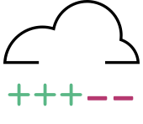
How Terraform Works Without Sentinel
VCS
Terraform
plan & apply
Infrastructure
Notes:
Here is how Terraform works without Sentinel.

Slide 14

How Terraform Works With Sentinel
VCS
Terraform
Cloud
Workspace
plan
Sentinel
Policy
Checks
apply
Infrastructure
If cost estimates are enabled, they run right after the plan.
Notes:
Here is how Terraform works with Sentinel.
Note that if cost estimates are enabled for the workspace, they will run right after the plan.

Slide 15
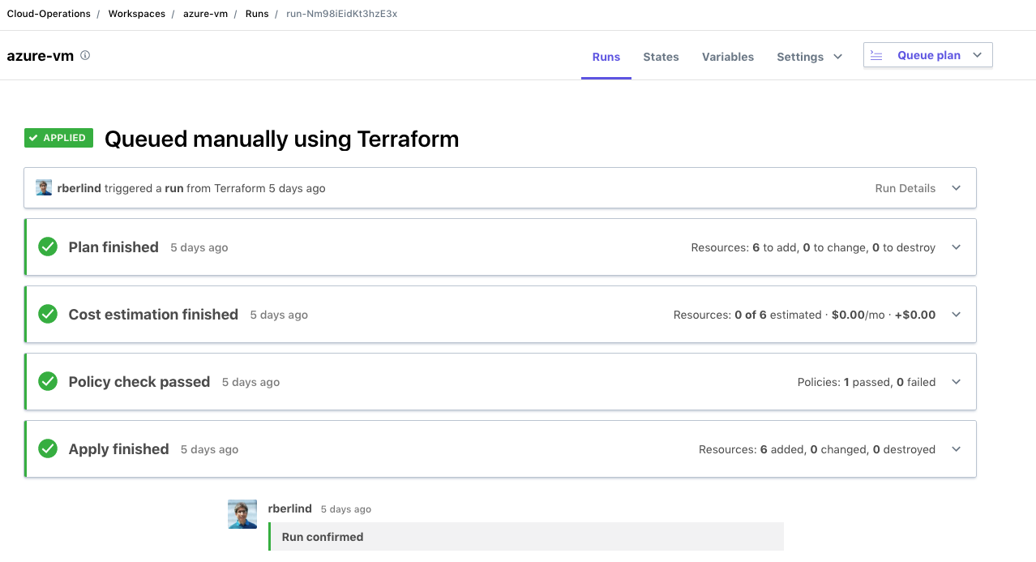
All Policy Checks Passed
Notes:
A screenshot from TFC showing that all policy checks passed for a run.

Slide 16
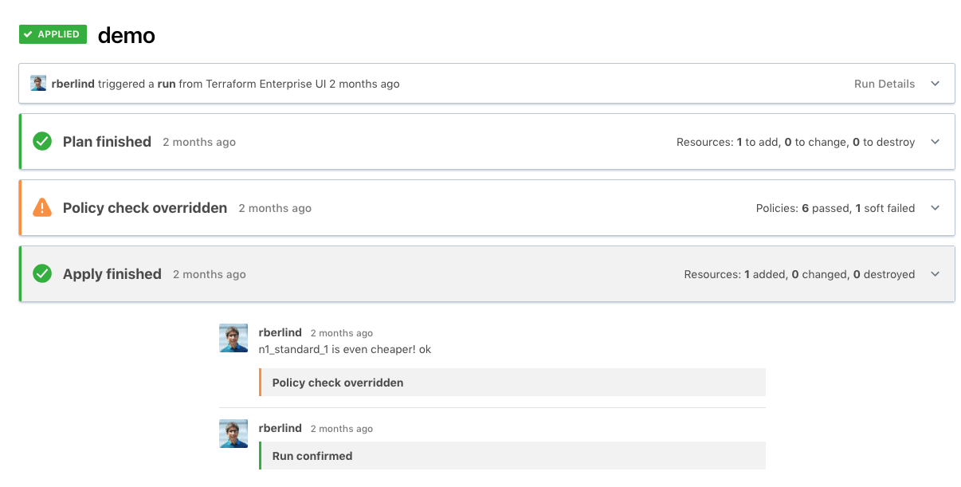
A Soft Mandatory Policy Check Was Overridden
Notes:
A screenshot from TFC showing a soft mandatory policy check that failed but was then overridden.

Slide 17
Sentinel Imports in Terraform
Terraform adds some additional Sentinel Imports:
The tfplan gives data generated from Terraform plans.
https://www.terraform.io/docs/enterprise/sentinel/import/tfplan.html
The tfconfig import gives data about the Terraform configuration.
https://www.terraform.io/docs/enterprise/sentinel/import/tfconfig.html
The tfstate import gives data about the current state of a workspace.
https://www.terraform.io/docs/enterprise/sentinel/import/tfstate.html
The tfrun import provides metadata for Terraform runs and their workspaces as well as cost estimate data.
https://www.terraform.io/docs/cloud/sentinel/import/tfrun.html
Notes:
This is a good point to discuss the Terraform-specific Sentinel imports.
Terraform Cloud/Enterprise adds 4 Sentinel imports beyond the standard ones.

Slide 18
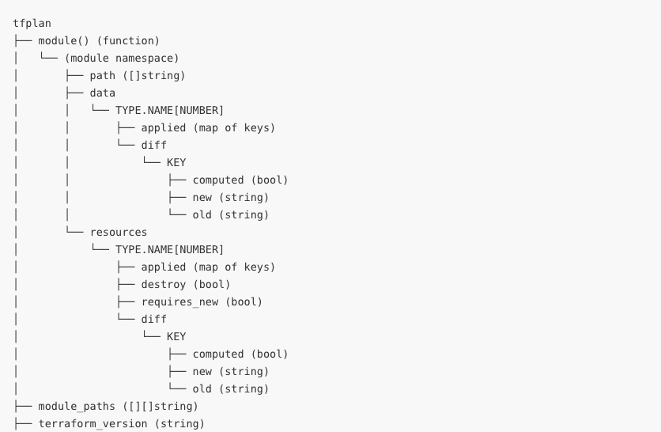
The tfplan Import's Namespace
Notes:
This screenshot from the tfplan import documentation shows most of the namespace of the tfplan import.
We have left off some aliases from the bottom of the namespace diagram that show some aliases.
See https://www.terraform.io/docs/cloud/sentinel/import/tfplan.html#namespace-overview for the full diagram.
What we want to focus on here is the organization of data exposed to the tfplan import for resources in each module under the resources namespace.
The data for resources is organized in 3 layers: type, name, number.
For more details, see https://www.terraform.io/docs/cloud/sentinel/import/tfplan.html#namespace-resources-data-sources

Slide 19
Example of tfplan Resource Data (1)
Recall the Terraform code we showed earlier that creates two instances of an "aws_instance" resource with name "ubuntu":
resource "aws_instance" "ubuntu" {
count = 2
ami = "${var.ami_id}"
instance_type = "${var.instance_type}"
}
Notes:
Recall the Terraform code that creates two instances of a resource of type "aws_instance" named "ubuntu".

Slide 20
Example of tfplan Resource Data (2)
The resource instances created by this code will appear in the tfplan import like this:
"resources": {
"aws_instance": {
"ubuntu": {
0: { "applied": {}, },
1: { "applied": {}, },
},
},
}
The data for resources is organized in 3 layers: type, name, number.
Notes:
The data for resources is organized in 3 layers: type, name, number.
Instance numbering starts at 0.
We have left off all the data that would be included for each instance.

Slide 21
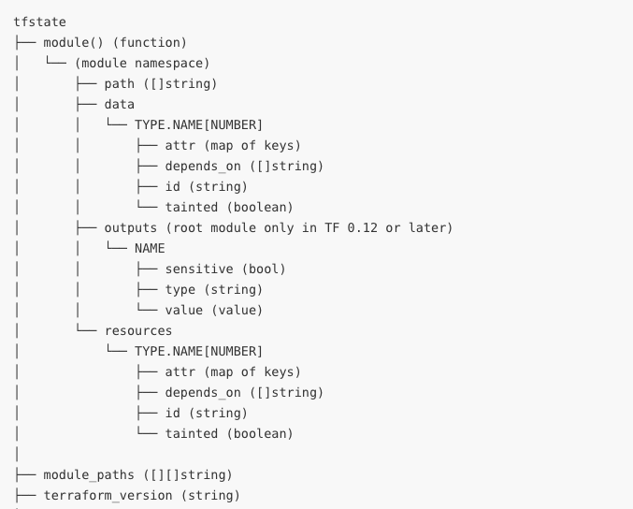
The tfstate Import's Namespace
Notes:
This screenshot from the tfstate import documentation shows most of the namespace of the tfstate import.
We have left off some aliases from the bottom of the namespace diagram that show some aliases.
See https://www.terraform.io/docs/cloud/sentinel/import/tfstate.html#namespace-overview for the full diagram.
What we want to focus on here is the organization of data exposed to the tfstate import for resources in each module under the resources namespace.
The data for resources is organized in 3 layers: type, name, number.
For more details, see https://www.terraform.io/docs/cloud/sentinel/import/tfstate.html#namespace-resources-data-sources

Slide 22
Using the tfstate Import
The tfstate import gives the state of resources and data sources after a plan.
Generally, this will be the same as the state before the plan, but it could include additional data for data sources that were evaluated during the refresh operation done by the plan.
Data sources that do not reference computed values are evaluated during the plan.
The evaluation of data sources that reference computed values is delayed until the apply.
As a consequence, the tfstate import is often more useful than the tfplan import when restricting data sources in policies.

Slide 23
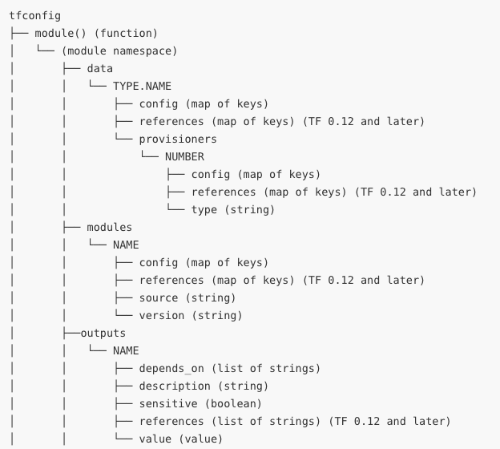
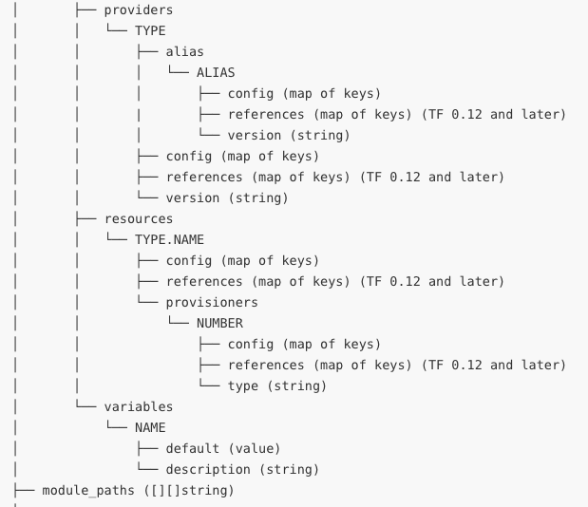
The tfconfig Import's Namespace
Notes:
This screenshot from the tfconfig import documentation shows most of the namespace of the tfconfig import.
We have left off some aliases from the bottom of the namespace diagram that show some aliases.
See https://www.terraform.io/docs/cloud/sentinel/import/tfconfig.html#namespace-overview for the full diagram.
What we want to focus on here is the organization of data exposed to the tfplan import for resources in each module under the resources namespace within the resources namespace.
The data for resources is organized in 2 layers: type and name.
For more details, see https://www.terraform.io/docs/cloud/sentinel/import/tfconfig.html#namespace-resources-data-sources

Slide 24
Using the tfconfig Import
The tfconfig import gives information about the Terraform configuration used by the run in which Sentinel policies are checked.
It does NOT give all information about the Terraform configuration.
It can be used to restrict the configuration of module calls, variables, resources, data sources, providers, provisioners, and outputs.
It it useful for restricting things that the other imports don't cover.
However, using it to restrict resources and data sources can be challenging because of the need to cross-reference references.
Notes:
The tfconfig import gives information about the Terraform configuration (code) used by the run.
But it does not give all information about the configuration. For instance, it does not include local values.
It can be used to restrict various things that are not covered by the other imports.
Cross-referencing of references should only be done by advanced users and only when a policy cannot be implemented with the tfplan and tfstate imports.

Slide 25
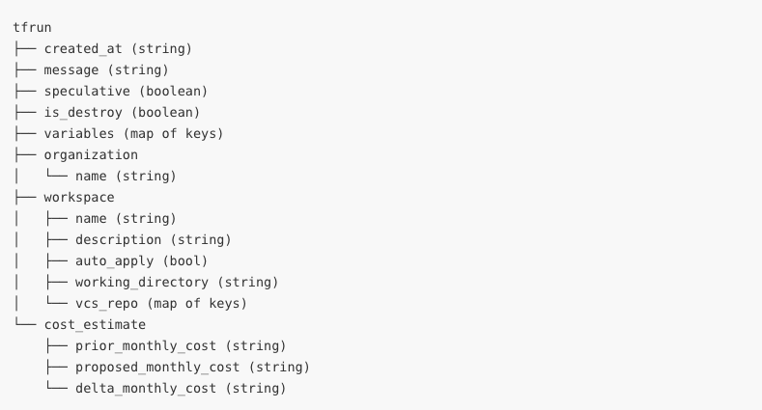
The tfrun Import's Namespace
Notes:
This screenshot shows the attributes and collections of the tfrun import.
This is from https://www.terraform.io/docs/cloud/sentinel/import/tfrun.html.

Slide 26
Using the tfrun Import
The tfrun import gives some useful information about a run and the workspace it was run in.
This includes the following:
The workspace's name, description, and other settings
Whether the plan was speculative or a destroy plan
A list of variables set for the run, indicating their names, their category (Terraform or Environment), and whether they were marked as sensitive.
Using the workspace name or description allows selective checking of policies against different workspaces. But only if control over their naming is exercised.
Notes:
The tfrun import gives some useful information about a run and the workspace it was run in

Slide 27
Sentinel Mocks in Terraform
Sentinel Mocks simulate the data that is made available to the Terraform Sentinel imports from Terraform plans.
They can be generated from recent plans using the Terraform Cloud UI and API.
They can also be copied and edited to simulate various combinations of resource and data source attributes.
They enable testing of Terraform Sentinel policies with the Sentinel CLI.
Using the Sentinel CLI with mocks speeds up development of new policies since plans do not need to be run.
Notes:
You can generate Sentinel mocks from Terraform plans in TFC/TFE.
You can then use these mocks when testing policies with the Sentinel CLI

Slide 28
Useful Sentinel Documentation
Main Sentinel Docs:
https://docs.hashicorp.com/sentinel
Terraform Enterprise Sentinel Docs:
https://www.terraform.io/docs/enterprise/sentinel/index.html
GitHub Repository with Sample TFE Policies for AWS, Azure, GCP, and VMware:
https://github.com/hashicorp/terraform-guides/tree/master/governance/second-generation
Guide to Writing and Testing Sentinel Policies in Terraform:
https://www.hashicorp.com/resources/writing-and-testing-sentinel-policies-for-terraform
Notes:
This slide gives some useful links that will help you learn how to use Sentinel in TFC and TFE and how to write your own Sentinel policies.
The instructor should show these links to the students.

Slide 29
Sentinel Language
Notes:
Let's spend some time discussing the Sentinel language.

Slide 30
Key Sentinel Language Constructs (1)
Boolean Expressions: Evaluate to true, false, or undefined.
They use logical, comparison, set, and other Operators.
(5*2 == 10) and (7 in [ 2, 3, 5, 7, 11, 13, 17, 19])
Rules: Evaluate simple and compound boolean expressions and can call functions that return boolean values.
Main Rule: Every Sentinel policy must have a rule called "main".
Combines the other rules with its own boolean expression.
Statements: Execute procedural logic.
Functions: Execute various statements and return a value.
Variables: Store values for use by rules and functions.
Parameters: Accept inputs passed to policies.
Notes:
Note that each rule can only contain a single, possibly complex boolean expression. Rules cannot include statements, for loops, or if/else statements.
If you need to do complex processing that cannot be done with a single boolean expression, define a function that returns a boolean value and call that function from your rule.
Rules can use the "all" and "any" expressions since these are rendered as chained "and" and "or" logical operators.

Slide 31
Key Sentinel Language Constructs (2)
Types: boolean, integer, float, string, list, map
A List is a collection of zero or more items
A Map is a collection of zero or more key/value pairs
Operators: Arithmetic, Logical, Comparison, Set, Matches, Else
Assignments: Set the value of variables.
If/Else and Case Statements: Specify conditional execution of different logic within a function.
For Loops: Repeat statements while iterating over a map or list.
Frequently used inside functions
Imports: Reusable libraries of Sentinel functions.
Notes:
The types.type_of() function from the types import gives the type of null as "null", so null can also be viewed as a type.
While Sentinel itself supports creation of custom imports, those cannot currently be imported into TFE.

Slide 32
Sentinel Keywords
all
any
as
break
case
continue
else
for
func
if
is
import
param
return
rule
when
Notes:
Sentinel has some keywords that should not be used as names of variables, functions, or rules.

Slide 33
Sentinel Pre-declared Identifiers
Constants:
false
true
null
undefined
Type Conversion Functions:
bool
float
int
string
Other Builtin Functions:
append
delete
error
keys
length
print
range
values
Notes:
Sentinel also has some pre-declared identifiers that should not be used as names of variables, functions, or rules.

Slide 34
Sentinel Numerical and Logical Operators
Arithmetic: +, -, *, /, and % (remainder)
p and q p and q must both be true
p or q at least one of them must be true
p xor q exactly one of them must be true
!p p is false
not p p is false
Notes:
Parentheses can be used to refine the processing in compound boolean expressions.
See https://docs.hashicorp.com/sentinel/language/boolexpr/#order-of-operations for the default order of operations.

Slide 35
Sentinel's Short-Circuit Logic
Sentinel applies Short-Circuit Logic for compound boolean expressions like p and q and (a and b) or c:
This means that Sentinel does not evaluate all conditions further to the right if it already knows the final answer.
So, if p is false, it does not evaluate q since p and q is already false.
If a and b are both true, it does not evaluate c since (a and b) or c is already true.
If a is false, it does not evaluate b since a and b is already false, but it does evaluate c since (a and b) or c could still be true or false, depending on the value of c.
Notes:
Sentinel uses short-circuit logic.
This means some conditions will not be evaluated.
It is important to understand when this might happen.

Slide 36
Sentinel Comparison Operators
== equal to
!= not equal to
< less than
<= less than or equal to
> greater than
>= greater than or equal to
is equal to
is not not equal to
Notes:
Here are Sentinel's comparison operators.

Slide 37
Sentinel Set Operators
1 in [1, 2, 3] Means that 1 is in the list
[1, 2, 3] contains 2 Means that the list contains 2.
You can also use not in and not contains.
Notes:
Here are Sentinel's set operators.

Slide 38
Sentinel Matches Operator
The matches operator tests if a string matches a regular expression.
It uses RE2 regex syntax.
Examples:
"test" matches "^te" # true
"1352" matches "[0-9]*" # true
"123A" matches "[0-9]*" # false
Note that the strings import can also be used to determine if a string has a specific prefix or suffix.
Notes:
Sentinel also has a matches operator that can be used to do regex matching.

Slide 39
Sentinel Else Operator
The else operator converts the undefined value to something else.
If a number is undefined, you might convert it to 0
(r.applied.memory else 0) <= 2048
If a boolean is undefined, you might convert it to true or false.
(r.applied.memory <= 2048) else false
If a list is undefined, you might convert it to the empty list, [].
values(tfplan.module(path).resources) else []
If a map is undefined, you might convert it to the empty map, {}.
tfplan.module(path).resources[type] else {}
Note that the else operator does not affect null.
Notes:
Sentinel's else operator is very important since it helps you avoid the undefined value in your policies.

Slide 40
Sentinel For Loops
A Sentinel for loop iterates over a collection.
count = 0
for [1, 2, 3] as num {
count += num
}
Each for loop uses the as keyword to define one or two iterator variables.
When iterating over a list as above, a single variable is used.
When iterating over a map, two variables can be used, the first for the keys and the second for the values of the map.
Notes:
The for loop is always used with the as keyword to declare iterator variables
When iterating over a list, only one iterator variable is used.
When iterating over a map, two are usually used, the first for the keys and the second for the values of the map.
If you only declare one iterator variable for a map, it will represent the values of the map.
See https://docs.hashicorp.com/sentinel/language/loops/#for-statements

Slide 41
Sentinel For Loop Examples
This example iterates over a list with one variable (for the values).
count = 0
for [1, 2, 3] as num {
count += num
}
The count will equal 6.
This example iterates over a map with two variables:
data = { "a": 12, "b": 32 }
for data as k, v {
sum += v
}
The sum will equal 44.
Notes:
The for loop is always used with the as keyword to declare iterator variables
When iterating over a list, only one iterator variable is used.
When iterating over a map, two are usually used, the first for the keys and the second for the values of the map.
If you only declare one iterator variable for a map, it will represent the values of the map.
See https://docs.hashicorp.com/sentinel/language/loops/#for-statements

Slide 42
The Sentinel all and any Expressions
The all and any expressions are are used like loops, but they are actually quantifier expressions that apply boolean expressions to collections. They return true or false.
The all expression is a universal quantifier asserting that a boolean expression must be true for all items of a collection.
The any expression is an existential quantifier asserting that a boolean expression must be true for at least one item in a collection.
It used to be common to use all expressions in Sentinel rules, but it is better to use for loops in functions called by the main rule.
This allows your policies to report all violations in a single shot.
Notes:
We will often refer to all and any expressions as loops because that is how they behave.
In functions, you would use for loops instead of the all expression.
We highly recommend avoiding the use of rules with the all and any expressions because of Sentinel's short-circuit logic which causes them to stop processing as soon as they see a violation of a condition.
It is much better to use for loops in functions.

Slide 43
The Sentinel filter Expression
The filter expression is also a quantifier expression that applies boolean expressions to collections.
However, instead of returning true or false, it returns a sub-collection of the original collection consisting of those items for which the boolean expression was true.
The filter expression is useful with the Terraform Sentinel v2 imports since their collections were designed to be used with it.
We'll see an example of this later.
Notes:
We will often refer to all and any expressions as loops because that is how they behave.
In functions, you would use for loops instead of the all expression.

Slide 44
The Sentinel If/Else Conditional
This example tests if v is defined and equal to value:
if v else null is null {
print(v, "was not defined")
} else if v is not value {
print(v, "is not equal to the required value", value)
} else {
print(v, "has the desired value", value)
}
Notes:
The for loop is always used with the as keyword to declare iterator variables
When iterating over a list, only one iterator variable is used.
When iterating over a map, two are usually used, the first for the keys and the second for the values of the map.
If you only declare one iterator variable for a map, it will represent the values of the map.
See https://docs.hashicorp.com/sentinel/language/loops/#for-statements

Slide 45
The Sentinel Case Conditional
This example does different processing for different days:
case day {
when "Saturday", "Sunday":
print("Sorry, we are closed.")
else:
print("We are open from 9am to 6pm.")
}
Notes:
The for loop is always used with the as keyword to declare iterator variables
When iterating over a list, only one iterator variable is used.
When iterating over a map, two are usually used, the first for the keys and the second for the values of the map.
If you only declare one iterator variable for a map, it will represent the values of the map.
See https://docs.hashicorp.com/sentinel/language/loops/#for-statements

Slide 46
Standard Sentinel Imports
Beyond the TFC Sentinel imports we already mentioned (tfplan, tfconfig, tfstate, and tfrun), you can also use these Standard Imports:
decimal
http
json
runtime
sockaddr
strings
time
types
units
Notes:
See https://docs.hashicorp.com/sentinel/imports
The http import currently only supports the HTTP GET operation against API endpoints that return JSON documents.
It is possible to send data to an API endpoint with the http import using headers or URL parameters.
See https://docs.hashicorp.com/sentinel/imports/http

Slide 47
Common Operations of the Standard Imports
Check if a string has a prefix: strings.has_prefix(s, prefix)
Check if a string has a suffix: strings.has_suffix(s, suffix)
Check the type of a Sentinel object: types.type_of(obj)
Make external calls to API endpoints:
response = http.get("https://example.hashicorp.com")
Convert a JSON object to a Sentinel structure:
json.unmarshal(response.body)
Notes:
See https://docs.hashicorp.com/sentinel/imports
The http import currently only supports the HTTP GET operation against API endpoints that return JSON documents.
It is possible to send data to an API endpoint with the http import using headers or URL parameters.
See https://docs.hashicorp.com/sentinel/imports/http

Slide 48
Sentinel Functions
Each Sentinel Function must currently be declared and defined in the body of the policy that uses it with the func keyword.
find_resources = func(resource_type) {
# Do something and use the parameter
return true
}
Each function has a name.
The name of the above function is find_resources.
Each function can have zero or more parameters.
The function above has the single parameter, resource_type
Every function must return a value.
The function above returns true.
Notes:
Functions are declared with the func keyword.
They all have a name.
They can also have parameters.
They must return a value.
See https://docs.hashicorp.com/sentinel/language/functions for more details.
In the future, it will be possible to declare functions in a policy without pasting their code.

Slide 49
Builtin Functions
Sentinel includes some useful Builtin Functions:
append Appends a value to the end of a list
delete Deletes an element from a map
error Immediately exit with an error message
keys Returns the keys of a map
length Returns the length of a collection or string
print Prints what you tell it to. Always returns true.
range Returns a list of numbers in a range.
values Returns the values of a map.
There are also Type Conversion functions, bool, float, int, and string, which convert other types to their type.
Notes:
Sentinel has some builtin functions that you can use in any policy.

Slide 50
Workshop Challenges: Using the Sentinel CLI Running Your First Sentinel Policy
Notes:
Now we will do the first two workshop challenges on the Instruqt platform

Slide 51
The Original Guide Exercises
The Writing and Testing Sentinel Policies for Terraform guide that this presentation is based on contains 5 exercises designed to make readers capable of independently writing and testing new Sentinel policies.
Those exercises intentionally did not provide step-by-step, copy-and-paste instructions since we feel it is better for people to try to write their own policies by following the guide's 8-step methodology.
That methodology includes reading Terraform provider documentation to determine the resources and attributes that a policy should focus on.
This approach can be effective for someone working by themself.
But this is more difficult in a workshop or class setting in which some participants will need more time than others.
Notes:
Later challenges in the workshop will guide you through the completion of some exercises from the Writing and Testing Sentinel Policies for Terraform guide.

Slide 52
The New Workshop Exercises
Fortunately, we found a happy medium between the step-by-step, copy-and-paste and the write everything yourself approaches.
You can now solve the exercises in an interactive learning platform, Instruqt, that HashiCorp has standardized on for workshops.
For this workshop, please use this track:
https://play.instruqt.com/hashicorp/tracks/sentinel-for-terraform-v1
We've made things easier by writing most of each policy and by providing the test cases and mocks needed to test it.
You need to finish each policy, save it, and then run the sentinel test command to verify that it behaves correctly.
Notes:
The new workshop exercises leverage the Instuqt platform and make solving the exercises much easier.

Slide 53
Instruqt Basics
The Instruqt platform organizes training content into Tracks consisting of multiple Challenges that must be solved in a specific order.
Each track launches one or more VMs and/or Docker containers and exposes terminals, file editors, and user interfaces on Tabs.
Information about each challenge is displayed on Note screens while it is loading. A Start Button will be shown when the challenge is ready.
Detailed instructions are listed in an Assignment to the right of the tabs.
You can click the Check Button to verify if you have completed the assignment. If you have, you will advance to the next challenge. Otherwise, you will be given a hint about what to do next.
We recommend you review Instruqt's own tutorial track for more details:
https://play.instruqt.com/instruqt/tracks/getting-started-with-instruqt
Notes:
Here are some basics about Instruqt.
You might also want to spend 5 minutes reviewing Instruqt's own tutorial track.

Slide 54
Workshop Challenges 1 & 2
We don't describe the challenges in detail here since the challenge note screens and assignments describe them.
The Sentinel CLI: Learn about the Sentinel CLI commands.
Run Your First Sentinel Policy: Apply and test your first policy.
Exercise 1: Restrict Vault authentication methods.
Exercise 2: Restrict AWS IAM access keys.
Exercise 3: Restrict domains of AWS CM (ACM) certificates.
Exercise 4: Restrict images used by GCP compute instances.
Exercise 5: Only allow modules from a Private Module Registry.
Extra Credit: Prevent auto apply on production workspaces.
Notes:
We're going to start off easy by learning how to run the Sentinel CLI commands.
We'll keep things easy by running a simple policy that requires numbers to be even.
Exercise 1 uses a resource from Terraform's Vault Provider and the tfplan import.
Exercise 2 uses a resource from Terraform's AWS Provider and the tfplan import.

Slide 55
Writing and Testing Sentinel Policies for Terraform
Notes:
Now let's walk through the basic 8 step methodology of the Writing and Testing Sentinel Policies for Terraform guide.

Slide 56
Testing Terraform Sentinel Policies
There are three methods of testing Terraform Sentinel Policies
Test them against actual Terraform code by using the TFC UI or the Terraform CLI with the remote backend.
Execute automated tests against actual Terraform code using the TFC API.
Use the Sentinel CLI with the tfplan, tfconfig, tfstate, and tfrun mocks which simulate output from Terraform plans.
We will focus on the third method which is quickest and allows you to test multiple scenarios in parallel.
Notes:
There are 3 methods of testing Sentinel policies.
We will focus on using the Sentinel CLI (previously called the Sentinel Simulator).

Slide 57
Basic Methodology for Restricting Resources
The eight steps of the methodology are:
Create a Terraform configuration that creates the resource.
Create a TFC workspace that uses your Terraform configuration.
Run a plan against the workspace.
Generate mocks against the plan in the TFC UI.
Write a new Sentinel policy.
Create test cases and test your policy with the Sentinel CLI.
Revise your policy and test cases until the latter all pass.
Deploy your policy to a TFE organization.
Notes:
This slide gives the basic 8 step methodology of writing and testing Sentinel policies from the Writing and Testing Sentinel Policies for Terraform guide.

Slide 58
Create a Terraform Configuration
Create a Terraform configuration that creates at least one instance of the resource your policy will restrict.
Include a main.tf file to create the resource.
Include a backend.tf file to configure the remote backend (if you would like to use the remote backend).
Use variables to set the values of the attributes being restricted.
Create more than one instance of the resource to test your policy's ability to correctly handle some that pass and some that fail.
If your policy iterates over all modules, then create the resource in multiple modules.
Notes:
Step 1 is to create a Terraform configuration that uses the resource that you want to restrict.

Slide 59
Create a Terraform Configuration: main.tf
variable "ami_id" {
default = "ami-2e1ef954"
}
variable "instance_type" {
default = "t2.micro"
}
resource "aws_instance" "ubuntu" {
count = 2
ami = "${var.ami_id}"
instance_type = "${var.instance_type}"
}
Notes:
We're only showing part of a Terraform configuration here.
A more complete version of this is at https://github.com/hashicorp/terraform-guides/tree/master/infrastructure-as-code/aws-ec2-instance

Slide 60
Terraform Terminology for Resources
Let's consider the declaration of the resource from the last slide.
resource "aws_instance" "ubuntu" {
count = 2
ami = "${var.ami_id}"
instance_type = "${var.instance_type}"
}
In this case, "aws_instance" is the Type of the resource while "ubuntu" is its Name.
Each occurrence of a resource is referred to as a Resource Instance.
This Terraform code will create two Instances of the resource.
Notes:
Note that in this case, "aws_instance" is the type if the resource while "ubuntu" is the name of the resource.
Each occurrence of a specific resource provisioned by Terraform is referred to as a resource instance.
This Terraform code will create two instances of the resource named "ubuntu" of type "aws_instance".

Slide 61
Create a Terraform Configuration: backend.tf
terraform {
backend "remote" {
hostname = "<your_TFE_server>"
organization = "<your_org>"
workspaces {
name = "<your_workspace>"
}
}
}
Notes:
Be sure to set valid values for hostname, organization, and the name of your workspace in your backend.tf file.

Slide 62
Generate a User API Token
In order to use the remote backend against a TFC/TFE server, you need to generate a User API Token for yourself.
You then need to list the token in your Terraform CLI configuration file.
On a Mac or Linux machine, this will be the .terraformrc file in your home directory.
On a Windows machine, this will be the terraform.rc file in your %APPDATA% directory.
The token should be added in a section like this:
credentials "app.terraform.io" {
token = "<token>"
}
Notes:
You'll need to generate a user API token if using the Terraform CLI with the remote backend.

Slide 63
Create a Terraform Cloud Workspace
Since you will trigger your plan with the remote backend in order to generate mocks, you do not need to set up a VCS connection.
Click "No VCS connection" when creating your workspace when prompted to connect to a version control provider.
You still need to add environment variables such as cloud credentials to your workspace since local ones are not sent to the server.
Several tools can push Terraform and environment variables:
set-variables.sh
tf-helper (tfh)
Notes:
Step 2 is to create a Terraform Cloud or Terraform Enterprise workspace in which you can run a plan against your Terraform configuration.

Slide 64
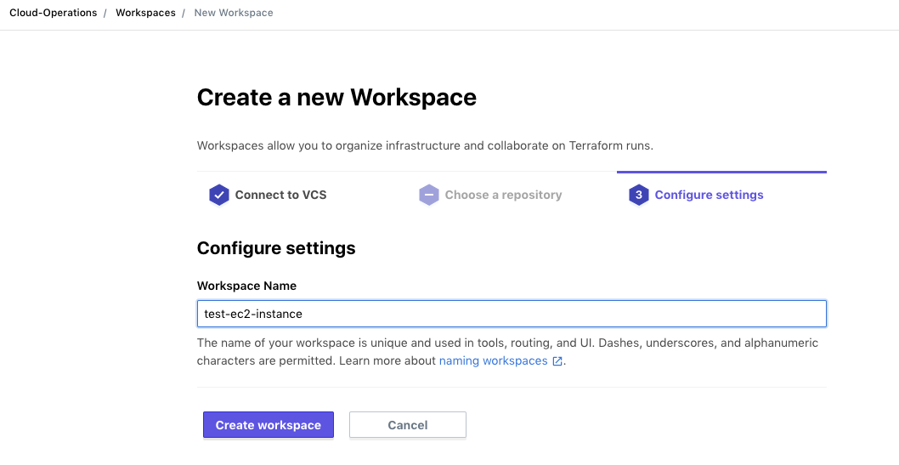
Create a Workspace in the TFC UI
Notes:
This screenshot shows creation of a workspace in the TFC UI.

Slide 65
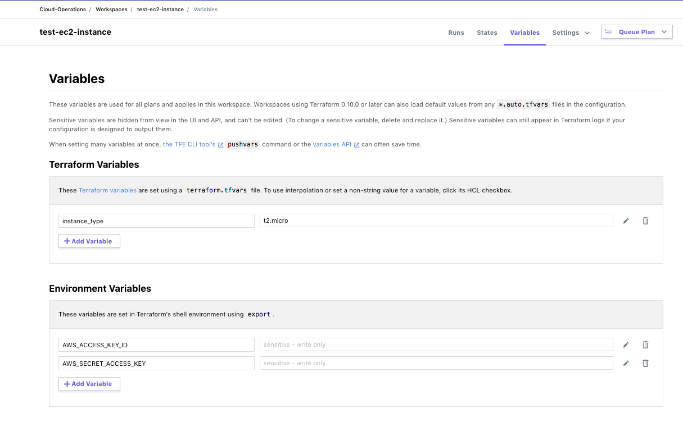
Set Variables in Your Workspace
Notes:
After creating a workspace, you will usually have to set some variables in it.
This could include both Terraform and Environment variables.

Slide 66
Run a Plan and Generate Mocks Against It
From your local directory containing main.tf and backend.tf, run terraform init to initialize your Terraform configuration.
Then run terraform plan
The plan will run on the TFC server, but its results will be visible locally and in the TFC UI.
To see the run in the TFC UI, copy the URL displayed near the top of the local version of the plan and navigate to it with a browser.
To generate mocks against your plan, click the "Download Sentinel mocks" button.
After a minute, a tar.gz file with 4 mocks will be downloaded.
Extract the mock files from the tar.gz file.
Notes:
Steps 3 and 4 are running a plan against your Terraform configuration in your workspace and generating mocks from the plan.

Slide 67
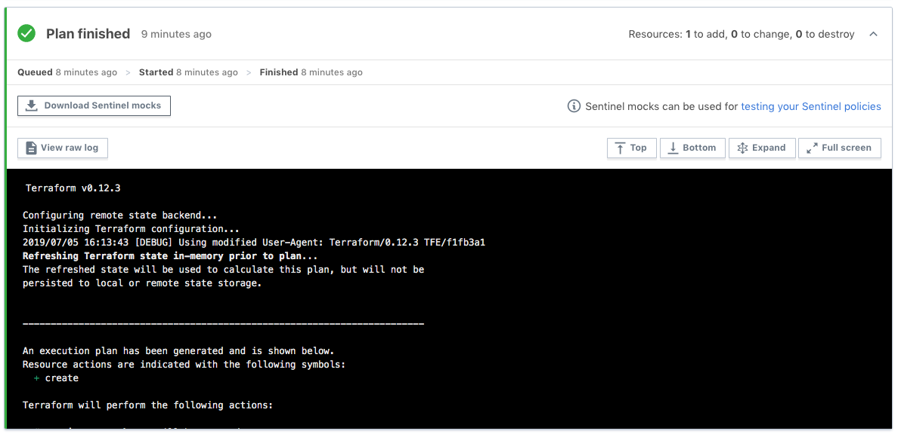
Generate Mocks Against Your Plan
Click this button
Notes:
This screenshot shows how mocks can be generated and downloaded.

Slide 68
Writing Sentinel Policies for TFC/TFE
Sometimes, you might be asked to create a Sentinel policy to restrict particular things such as VMs or load balancers.
But you might not know the exact Terraform resources that implement these.
Fortunately, you can use the Terraform Provider documentation to identify resources that implement the things you want to restrict.
Each resource and data source has its own documentation page.
Looking at documentation from the underlying cloud service provider or other technology will also help.
For instance, you can determine valid values for VM size.
Notes:
Often, when someone asks you to write a Sentinel policy for Terraform, you might not know what resources to use
You might also not know what attributes the resources have or which ones to focus on.
You'll want to review the Terraform Provider documentation for the relevant provider.
Start your search for Terraform providers at https://www.terraform.io/docs/providers/index.html
After selecting a provider, you can filter for resources that match what you type.

Slide 69
Writing a Terraform Sentinel Policy
The next set of slides walks you through a Sentinel policy called "restrict-ec2-instance-type.sentinel" that restricts the allowed sizes of AWS EC2 instances.
It breaks down the Sentinel code into smaller bites, clarifying what each section of the code is doing.
Use any text editor and save the file with the name:
restrict-ec2-instance-type.sentinel
Notes:
Step 5 is to write a Sentinel policy.
Let's walk through one over several slides.

Slide 70
Sentinel Import Declarations
# Use the standard tfplan and strings imports
import "tfplan"
import "strings"
Notes:
We need to import any standard imports and any TFE Sentinel imports (tfplan, tfconfig, tfstate, and tfrun) before we can use them.

Slide 71
Sentinel Function to Find Resources
find_resources_from_plan = func(type) {
resources = {}
for tfplan.module_paths as path {
for tfplan.module(path).resources[type] else {} as name, instances {
for instances as index, r {
if length(path) == 0 {
address = type + "." + name + "[" + string(index) + "]"
} else {
address = "module." + strings.join(path, ".module.") + "." +
type + "." + name + "[" + string(index) + "]"
}
resources[address] = r
}
}
}
return resources
}
Notes:
This re-usable function shows the best practice of iterating over all Terraform modules to find all resources of a certain type in the tfplan import.
This function accepts a string parameter that is the type of a Terraform resource.
We iterate over all modules, then over all named resources of the specified type, then over all instances of each named resource.
We build the address in the standard module.A.module.B.<type>.<name>[index] format.
We return a map of resource instances indexed by their full address.
The function can then be called to actually get the results into a variable.

Slide 72
Function that Restricts Instance Size (1)
validate_attribute_in_list = func(type, attribute, allowed_values) {
validated = true
resource_instances = find_resources_from_plan(type)
for resource_instances as address, r {
# Skip resource instances that are being destroyed
if r.destroy and not r.requires_new {
print("Skipping resource", address, "that is being destroyed.")
continue
}
# Determine if the attribute is computed
if r.diff[attribute].computed else false is true {
print("Resource", address, "has attribute", attribute,
"that is computed.")
# validated = false
Notes:
The generic, re-usable validate_attribute_in_list() function takes three arguments: type, attribute, and a list of allowed values
We initialize validated to true so that the function will return true unless there are any violations.
We call the find_resources_from_plan function, passing it the type variable (which will be "aws_instance")
We loop over the resource instances with a for loop.
Note that the for loop uses as to declare the iterator variables for the loop with address giving the keys and r giving the values of the resource_instances map.
We skip resources that are being destroyed since policy violations for them are not usually useful.
We check if the attribute is computed since Sentinel cannot evaluate computed attributes.
If we wanted to be strict, we could set validated to false for computed values.

Slide 73
Function that Restricts Instance Size (2)
} else {
# Validate that each instance has allowed value
if r.applied[attribute] else "" not in allowed_values {
print("Resource", address, "has attribute", attribute,
"with value", r.applied[attribute] else "",
"that is not in the allowed list:", allowed_values)
validated = false
}
}
}
return validated
}
Notes:
If the attribute is not computed, we check whether it is in the allowed_values list
Note the use of r.applied[attribute] which gives the predicted post-apply value of the attribute of the resource that would exist if the apply were allowed to run.
In a more specific case that used a specific attribute like instance_type, you could use r.applied.instance_type.
If not, we print a violation message and set validated to false.
The print function is NOT just for debugging. You should always print clear violation messages.
Finally, we return validated which will be true if there were no violations or false if there were any.
Note that we iterate across all resource instances of the specified type and print violation messages for all violations.
This avoids the bad practice of first generation Sentinel policies which only reported the first violation.

Slide 74
Lists in Sentinel Policies
# Allowed EC2 Instance Types
allowed_types = [
"t2.small",
"t2.medium",
"t2.large",
]
Notes:
We give a list of allowed EC2 instance types.
A list contains multiple items separated by commas.
If the closing bracket is on a line by itself, then the last item must have a comma after it.
If you put the closing bracket on the same line as the last item, you can leave out the final comma.

Slide 75
Main Rule in a Sentinel Policy
# Call the validation function
instances_validated = validate_attribute_in_list(
"aws_instance", "instance_type", allowed_types)
# Main rule that evaluates the results
main = rule {
instances_validated
}
Notes:
We call the validate_attribute_in_list() function right before the main rule with the "aws_instance", "instance_type", and allowed_types list as arguments and assign the results to a boolean variable, instances_validated.
The main rule will pass if the function returns true but fail if it returns false.
While we could call the function inside the main rule, calling it outside and passing the result minimizes Sentinel's default printing which we don't need because our policy is explicitly printing what we care about.

Slide 76
Creating Test Cases for the CLI (1)
To test your policy with the Sentinel CLI, you first need to set up test cases that use the tfplan mock you generated earlier.
Under the directory containing your policy, create a test directory.
Under the test directory, create a directory with the same name as your policy, but without the ".sentinel" extension.
So, for our restrict-ec2-instance-type.sentinel policy, we create the restrict-ec2-instance-type directory under the test directory.
Copy the mock-tfplan.sentinel mock file that you downloaded and extracted from your workspace to this directory.
Notes:
Step 6 is to set up test cases for use with the Sentinel CLI and then test your policy.
The Sentinel CLI is particular about the organization and names of directories for test cases.
We need to create a test directory under the directory containing policies.
We need to create directories for each policy under the test directory.

Slide 77
Creating Test Cases for the CLI (2)
Copy the mock-tfplan.sentinel mock file that you downloaded and extracted from your workspace to this directory.
Change the name of the mock file to mock-tfplan-pass.sentinel.
Create a second copy of the file and call it mock-tfplan-fail.sentinel.
Create a pass.json file that looks like this:
{
"mock": {
"tfplan": "mock-tfplan-pass.sentinel"
},
"test": {
"main": true
}
}
Notes:
We are creating two test cases: one that will pass and one that will fail.
Each will have its own copy of the mock file that was generated from our plan.
But we will edit those mocks to have different values of the attribute we are testing.
If using tfconfig, tfstate, or tfrun mock files, you need to specify the mock type accordingly (instead of using "tfplan").

Slide 78
Creating Test Cases for the CLI (3)
Create a fail.json file that looks like this:
{
"mock": {
"tfplan": "mock-tfplan-fail.sentinel"
},
"test": {
"main": false
}
}
Sometimes, you will want multiple fail test cases to test multiple ways in which a policy could fail. Each will have its own mock file.
Notes:
Note that the fail test case says that the main rule should evaluate to false.
This means that the fail test case will pass (and give green output) when the main rule returns false against mock-tfplan-fail.sentinel.
This can be confusing to new users of the Sentinel CLI since they expect the fail test case to fail and give red output.
We note in the slide that you might sometimes want multiple fail test cases.

Slide 79
Creating Test Cases for the CLI (4)
Edit the mock-tfplan-pass.sentinel mock file and make sure that all values of instance_type are set to a value such as "t2.small" that is in the allowed_types list.
Edit the mock-tfplan-fail.sentinel mock file and make sure that at least one value of instance_type is set to a value such as "m5.large" that is not in the allowed_types list.
Sometimes, you will want multiple pass test cases.
Notes:
You also need at least one pass test case.
There are also cases in which you will want multiple pass test cases.

Slide 80
Testing Your Policy with the CLI (1)
Now that you have set up your test cases, you can test your policy with the Sentinel CLI.
Navigate back to the directory containing your policy.
Run the following command:
sentinel test –run=ec2
To see the outputs of the print statements, change this to:
sentinel test –run=ec2 –verbose
You can also apply a policy with the sentinel apply command, but you must set up a Sentinel configuration file that references any required mock files.
Notes:
We use the "sentinel test" command to test policies.
We use the –run argument to indicate which policy we want to run, using a partial name that suffices to uniquely identify the policy.
We can also specify the full policy name: "sentinel test –run=restrict-ec2-instance-type.sentinel".
We use the –verbose argument to see output from print statements.
For using the sentinel apply command, see https://docs.hashicorp.com/sentinel/commands/apply
For Sentinel configuration files, see https://docs.hashicorp.com/sentinel/commands/config

Slide 81
Testing Your Policy with the CLI (2)
The first command gives:
PASS - restrict-ec2-instance-type.sentinel
PASS - test/restrict-ec2-instance-type/fail.json
PASS - test/restrict-ec2-instance-type/pass.json
The second command gives:
PASS - restrict-ec2-instance-type.sentinel
PASS - test/restrict-ec2-instance-type/fail.json
logs:
Resource aws_instance.ubuntu[0] has attribute instance_type with value m5.large that is not in the allowed list: ["t2.small" "t2.medium" "t2.large"]
FALSE - restrict-ec2-instance-type.sentinel:95:1 - Rule "main"
PASS - test/restrict-ec2-instance-type/pass.json
TRUE - restrict-ec2-instance-type.sentinel:95:1 - Rule "main"
Notes:
We have condensed the output for the verbose option a bit.
We emphasize again that the fail.json test case passes and has green output even though the main rule for it returned false.
This is by design. All test cases should be configured to pass.
Step 7 is to revise your policy and test cases until the latter all pass
Step 8 is to deploy your policy to TFE organizations

Slide 82
Workshop Challenge: Write Your First Policy
Notes:
You will now do the next Instruqt challenge which is Exercise 1.

Slide 83
Workshop Challenge: Write Your First Policy
We don't describe the challenges in detail here since the challenge note screens and assignments describe them.
The Sentinel CLI: Learn about the Sentinel CLI commands.
Run Your First Sentinel Policy: Apply and test your first policy.
Exercise 1: Restrict Vault authentication methods.
Exercise 2: Restrict AWS IAM access keys.
Exercise 3: Restrict domains of AWS CM (ACM) certificates.
Exercise 4: Restrict images used by GCP compute instances.
Exercise 5: Only allow modules from a Private Module Registry.
Extra Credit: Prevent auto apply on production workspaces.
Notes:
Exercise 1 uses a resource from Terraform's Vault Provider and the tfplan import.
We have written most of the policy for you and provided test cases and mock files.
You just have to finish the policy.

Slide 84
Challenge Flow
After launching each challenge, you should read the note screens while the challenge loads to learn about the challenge's task:
Most challenges have 2 note screens with useful links that will help you solve them.
When the "Start" button appears, click it to view the challenge's assignment and begin following the instructions.
Each challenge (after the first) in this workshop has 3 tabs:
The Policy tab lets you edit a policy.
The Test Cases tab lets you inspect test cases and the mocks.
The Sentinel CLI tab lets you run the sentinel test command.
Notes:
We discuss the basic challenge flow here

Slide 85
Completing the Sentinel Policies (1)
By reviewing the note screens before each challenge, the links in them, the challenge assignment, these slides, and/or specific sections of the Writing and Testing Sentinel Policies for Terraform guide, you should be able to successfully complete each policy.
We also want to emphasize that you do not need any cloud accounts or HashiCorp software to write and test the policies since you will be using the Sentinel CLI in a Docker container loaded by the track to test the policies after you complete them.
You will need to replace placeholders like <resource_type>, <attribute>, and <condition> in each policy with suitable Sentinel expressions or values in order to complete the policies.
Notes:
Please note that the PDF version of the guide which you can download from the link has better formatting in some places than the online HTML.

Slide 86
Completing the Sentinel Policies (2)
Be sure to look at the suggested Terraform provider link for each challenge; this will help you identify a resource or data source and one of its attributes to use.
Also look at suggested links about specific Sentinel features.
Replace as many of the placeholders as you can. If you cannot replace one of them, save the policy and click the Check button to get a hint.
This might give you a useful hint. If not, try removing the placeholder, saving the policy, and clicking the Check button again to receive a bigger hint.
After replacing all the placeholders, be sure to save the file and run the sentinel test command with the specified arguments. All test cases should pass. If not, edit the policy and test it again.
Notes:
Looking at the mock files of each challenge can also help you determine the resource or data source and its relevant attribute to use, but we discourage you from doing that unless absolutely necessary since when you write your own policies, you will have to review the Terraform provider docs first in order to write some Terraform code from which you will generate mock files after running a plan against it. Looking at the mock files is a mild form of cheating.

Slide 87
Using Sentinel in Terraform Cloud and Terraform Enterprise
Notes:
While we won't be using Sentinel in Terraform Cloud or Terraform Enterprise today, we did want to review this topic
After all, that is where your Sentinel policies will really be running.

Slide 88
Testing Policies in Terraform Cloud
After successfully testing a policy with the CLI, you might also want to test it against actual Terraform code on a TFC or TFE server.
When doing this, we suggest you follow these recommendations:
Put each new policy in a policy set that does not contain any other policies.
Assign the workspaces you will be using to test your policy to that policy set.
Do not assign any other workspaces to the policy set.
Set the policy enforcement level to hard mandatory.
Following these recommendations will make your testing easier:
You won't see results from other policies.
You won't have to worry about overriding soft-mandatory failures.
Notes:
After testing new Sentinel policies with the Sentinel CLI, you can test them in an organization on a TFC or TFE server.

Slide 89
Creating Policy Sets with Policies
Policy Sets are created in a VCS repository.
Each policy set contains the policies and a configuration file called "sentinel.hcl" that lists the policies and their enforcement levels.
policy "restrict-ec2-instance-type" {
enforcement_level = "soft-mandatory"
}
You then configure the policy set in the Terraform Cloud UI by registering it, indicating the repository, branch, and policies path.
You can also specify Parameters for it including sensitive ones.
You also determine the workspaces it should be enforced on.
Notes:
You'll need to create policy sets that contain the policies you want to use in TFC or TFE

Slide 90
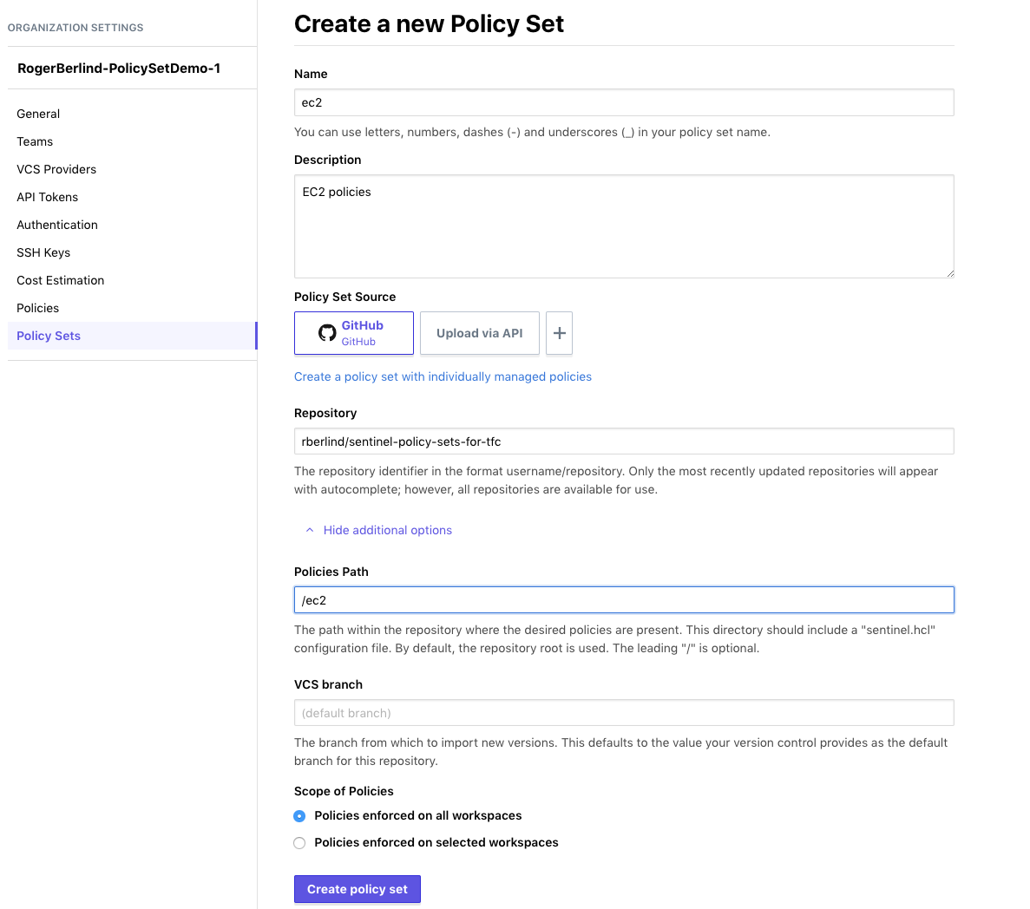
Notes:
This screenshot shows a VCS-backed policy set being registered in a TFC organization.

Slide 91
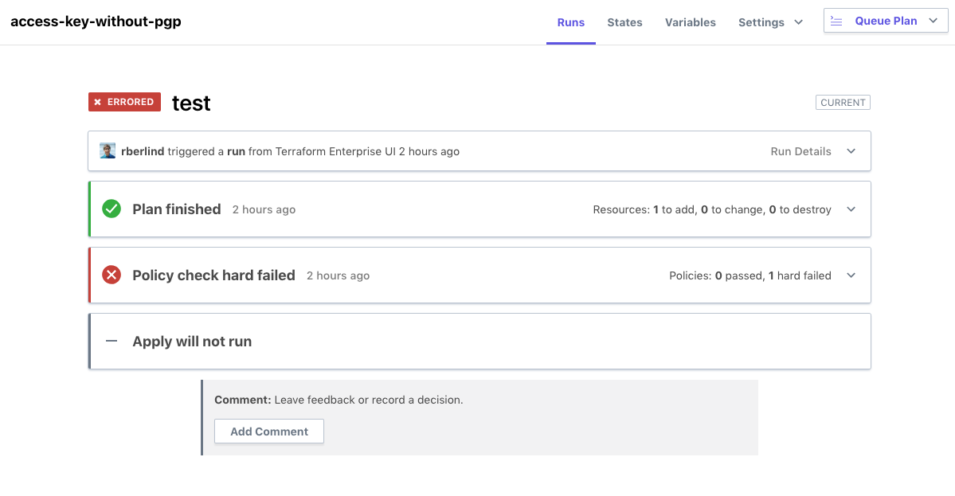
Sentinel Policy that Fails
Notes:
This screenshot shows a Sentinel policy check failing during a run in a TFC workspace.

Slide 92
Sentinel Policy that Fails
Sentinel evaluated to false because one or more Sentinel policies evaluated to false. This false was not due to an undefined value or runtime error.
1 policies evaluated.
## Policy 1: restrict-ec2-instance-type.sentinel (soft-mandatory)
Result: false
Print messages:
aws_instance ubuntu-0 has instance type m5.large that is not in the list ["t2.small" "t2.medium" "t2.large"]
FALSE - restrict-ec2-instance-type.sentinel:78:1 - Rule "main"
FALSE - restrict-ec2-instance-type.sentinel:74:3 - validate_instance_types()
FALSE - restrict-ec2-instance-type.sentinel:73:1 - Rule "instance_type_allowed"
Notes:
This screenshot shows more details of a Sentinel policy failing during a run in a TFC workspace.

Slide 93
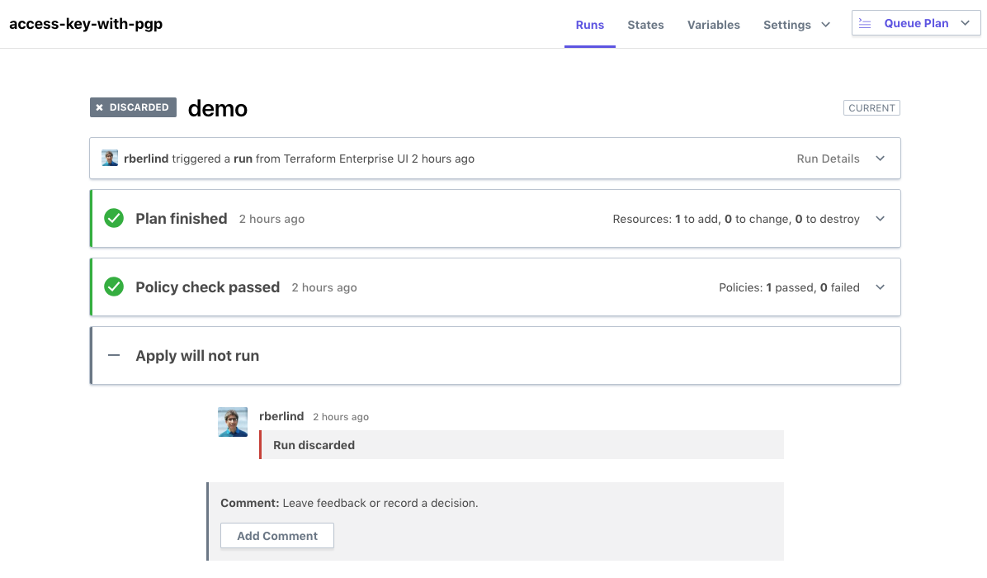
Sentinel Policy that Passes
Notes:
This screenshot shows a Sentinel policy check passing during a run in a TFC workspace.

Slide 94
Sentinel Policy that Passes
Sentinel Result: true This result means that Sentinel policies returned true and the protected behavior is allowed by Sentinel policies.
1 policies evaluated.
## Policy 1: restrict-ec2-instance-type.sentinel (soft-mandatory)
Result: true
TRUE - restrict-ec2-instance-type.sentinel:78:1 - Rule "main"
TRUE - restrict-ec2-instance-type.sentinel:74:3 - validate_instance_types()
TRUE - restrict-ec2-instance-type.sentinel:73:1 - Rule "instance_type_allowed"
Notes:
This screenshot shows more details of a Sentinel policy passing during a run in a TFC workspace.

Slide 95
Deploying Policies in Terraform Cloud
After successfully testing a policy with the CLI and possibly also on TFC itself, you will want to deploy it to your TFC organizations.
If you have not already added the policy to a policy set in your organizations, do that at this time.
Add the new policy to an existing policy set that is already applied against desired workspaces, or create a new policy set for the policy and apply that policy set to desired workspaces across your organizations.
Also add any parameters the policy requires to your policy set.
Notes:
After testing a policy with the Sentinel CLI and possibly in a TFC/TFE organization, you'll want to deploy it to your TFC organizations.

Slide 96
Advanced Techniques
Notes:
In this section, we discuss some advanced techniques for writing Sentinel policies for Terraform.

Slide 97
Debugging Policies with Errors
If your policy shows any errors, these might tell you which lines of your policy you need to fix.
A message like "An error occurred: <policy>.sentinel:34:10" means Sentinel encountered an error in column 10 of line 34 of the policy.
But the problem that caused the error could occur earlier in the code.
Some errors are caused by simple things like missing commas or braces. These are fairly easy to spot.
Other errors might be caused by missing or computed attributes or by null values. Consider adding checks that test for these possibilities.
Add extra print statements to help you narrow down where the error is occurring.
You can even print the entire resource: print("resource:", r)
Notes:
But remember that the print() function is not just for debugging!
Be sure to print clear violation messages that report the full address of violating resources or data sources for all violations.

Slide 98
Checking for Missing Expressions
An expression can fail to exist in multiple ways:
It could be absent from the data which gives undefined.
It could be set to null or the empty string ("").
It could be an empty map, {}, or an empty list, [].
Verify an expression is not undefined, null, or "":
r.applied.memory else null not in [null, ""]
Verify an expression is not undefined, null or an empty map, list, or string:
not ((x else null is null) or (types.type_of(x) in ["map", "list", "string"] and length(x) is 0))
The length() function can only be applied to strings, maps, and lists, so the type of an expression should be checked before using it.
Notes:
Using `x else null not in [null, ""]` checks that an attribute is not undefined, null, or an empty string (""). If x is missing, it will be undefined, but the else operator will convert it to null. So, we don't include undefined in the list.
You could use `x else "" not in [null, ""]` to achieve the same result.
Using `r.applied.size else null is not null` lets you check that an attribute is neither undefined nor null but it does not prevent "".
Using `r.applied.size else "" is not ""` lets you check that an attribute is neither undefined nor the empty string, "", but it does not prevent null.
Which expression you use depends on what values the attribute you are testing could have; some will have null (especially with Terraform 0.12) while others might have "". So, using these simplified conditions is ok when you know what to expect.
The order of conditions in compound expressions is important to avoid errors. In the last compound condition, if x is undefined, the first condition inside not (...) converts it to null, making the first condition true. And if the first expression is true (because x is null or undefined), Sentinel's short-circuit logic prevents the rest of the conditions inside not(...) from being evaluated, so we don't have to worry about undefined or null in them. (Note that length(null) gives undefined and would cause an error without short-circuit logic.)
The expression `types.type_of(null)` gives "null", so passing null to it would be ok, but `types.type_of(undefined)` gives undefined and would also cause an error without short-circuit logic.

Slide 99
Restricting Multiple Attributes in a Policy
If you want to restrict multiple attributes in a single policy, you can use your own custom function that tests all of them while iterating over the resource instances just once.
In this case, you should return a separate boolean for each condition in a map.
You will then return the map of booleans.
Alternatively, you could make more than one call to one or more of the standardized functions.
As in our previous example, we recommend calling your validation functions before your main rule and evaluating the booleans they return in the main rule to minimize verbose Sentinel output.
Notes:
Sometimes, you will want to restrict multiple attributes of a resource or data source in a policy.

Slide 100
Restricting Nested Attributes in a Policy (1)
The example common functions only handle top-level attributes of resources and data sources.
If you want to restrict a nested attribute of a resource or data source, you will need to define your own custom validation function.
As in our previous example, we recommend calling your validation function before your main rule and evaluating the boolean it returns in the main rule to minimize verbose Sentinel output.
Notes:
Sometimes, you will need to restrict nested attributes of resources or data sources in a policy.

Slide 101
Restricting Nested Attributes in a Policy (2)
Nested attributes in the applied value of the tfplan import:
r.applied.storage_image_reference[0].publisher
r.applied.boot_disk[0].initialize_params[0].image
Note that blocks in Terraform resources are treated by Sentinel as lists of maps even when only one occurrence of the block is allowed.
The first index of a Sentinel list is always 0.
Nested attributes in the diff value of the tfplan import:
r.diff["storage_image_reference.0.publisher"].computed
r.diff["boot_disk.0.initialize_params.0.image"].computed
Count keys in the diff are % for maps and # for lists:
r.diff[attribute + ".%"].computed (check the count of a map)
r.diff[attribute + ".#"].computed (check the count of a list)
Notes:
See https://www.hashicorp.com/resources/writing-and-testing-sentinel-policies-for-terraform#dealing-with-lists-maps-and-blocks for more about dealing with maps, lists, and blocks in Sentinel

Slide 102
Working with Data Sources
Our sample policy restricted the attribute of a resource.
Restricting the attribute of a data source is quite similar.
However, it is important to keep in mind that Terraform evaluates data sources at different times:
If a data source does not reference any computed values, it is evaluated during the refresh call in the plan step of the run.
If a data source does reference any computed values, it is evaluated during the apply step of the run.
In the first case, the information will be in the tfstate import.
In the second case, the information will be in the tfplan import.
In either case, some information will be in the tfconfig import.
Notes:
Some example policies that evaluate data sources:
https://github.com/rberlind/sentinel-training-solution/blob/master/sentinel-policies/restrict-acm-certificate-domains.sentinel
https://github.com/hashicorp/terraform-guides/blob/master/governance/second-generation/cloud-agnostic/blacklist-datasources.sentinel
The first uses the tfstate import since it expects the data source to not have computed values and therefore be evaluated during the plan and have data in the tfstate import.
The second uses the tfconfig import since it is focused on blacklisting data sources regardless of whether they have computed values or not. In this case, the policy does not need to evaluate attributes of the data sources, so using the tfconfig import works well.

Slide 103
Using the tfstate Import
The applied value of a resource in the tfplan import combines the current state of the resource prior to a run with the changes being made by the plan (the resource's "diff") to generate a predicted representation of what the resource's state will be after the apply.
So, most of what you might want to learn about the current state of a workspace is already exposed through the tfplan import.
However, the tfstate import does expose the depends_on, tainted, and id values of each resource and data source.
It also exposes the values of outputs.
The tfstate import uses the attr value instead of the applied value for resources and data sources.
Finally, as mentioned in the previous slide, the tfstate import can be used to evaluate data sources that do not use computed values.
Notes:
Some policies will need to use the tfstate import to check existing state or to evaluate data sources that do not use computed values.

Slide 104
Using the tfconfig Import
Some Sentinel policies need to restrict things that are only available in the tfconfig import.
Providers and Provisioners,
Module Sources and Versions
Metadata for Variables and Outputs
The tfconfig import can also be used to introspect the actual code contained in a Terraform configuration.
This allows attributes of different resources to be compared even if they are computed.
This can also be useful for enforcing Terraform code conventions.
The tfconfig import uses the config and references values instead of the applied value for resources and data sources.
Notes:
Some policies will need to use the tfconfig import, especially if trying to restrict providers, provisioners, and module sources & versions.

Slide 105
Using the tfrun Import
There are two main use cases for the tfrun import:
Restricting the costs of cloud resources by evaluating cost estimates generated for AWS, Azure, and GCP between the plan and the running of Sentinel policy checks.
Selectively applying policy conditions to different workspaces based on their names:
For instance, don't allow Auto Apply to be set in workspaces with names starting in "prod-" or ending in "-prod".
Additional use cases will likely be addressed as the tfrun import is expanded.
Notes:
Some policies will need to use the tfrun import, especially if inspecting TFC's cost estimates.

Slide 106
Making Calls to External API Endpoints
Sentinel policies in Terraform Cloud and Terraform Enterprise can use the http import to call external API endpoints.
Currently, the http import only supports the HTTP GET operation against API endpoints that return JSON documents.
In the future, it might also support API endpoints that return XML.
The http import can send data to an API endpoint with the http import using headers or URL parameters.
But sending data in the URL parameters is insecure, and there are limits on the size of headers.
Some example policies that use the http import are here.
Notes:
Sentinel's HTTP import can be used in policies to call external API endpoints.

Slide 107
Workshop Challenges: Write More Policies
Notes:
Now, you will do some more workshop challenges, using the Instruqt platform.
You will complete some more policies from the exercises of the Writing and Testing Sentinel Policies for Terraform guide.

Slide 108
Workshop Challenges: Write More Policies
We don't describe the challenges in detail here since the challenge note screens and assignments describe them.
The Sentinel CLI: Learn about the Sentinel CLI commands.
Run Your First Sentinel Policy: Apply and test your first policy.
Exercise 1: Restrict Vault authentication methods.
Exercise 2: Restrict AWS IAM access keys.
Exercise 3: Restrict domains of AWS CM (ACM) certificates.
Exercise 4: Restrict images used by GCP compute instances.
Exercise 5: Only allow modules from a Private Module Registry.
Extra Credit: Prevent auto apply on production workspaces.
Notes:
Exercise 2 uses a resource from Terraform's AWS Provider and the tfplan import.
Exercise 3 uses a data source from Terraform's AWS provider and the tfstate import.
Exercise 4 uses a resource from Terraform's Google Provider and the tfplan import. It also uses a doubly-nested attribute which requires using the types import to check that its parent attribute is really a list.
Exercise 5 uses the tfconfig import to restrict the source of two Terraform modules that create Azure resources.
The Extra Credit challenge uses the tfrun import to illustrate selective application of a policy condition to different workspaces based on their names.

Slide 109
Challenge Flow
After launching each challenge, you should read the note screens while the challenge loads to learn about the challenge's task:
Most challenges have 2 note screens with useful links that will help you solve them.
When the "Start" button appears, click it to view the challenge's assignment and begin following the instructions.
Each challenge (after the first) in this workshop has 3 tabs:
The Policy tab lets you edit a policy.
The Test Cases tab lets you inspect test cases and the mocks.
The Sentinel CLI tab lets you run the sentinel test command.
Notes:
Let's review the challenge flow again

Slide 110
Completing the Sentinel Policies (1)
By reviewing the note screens before each challenge, the links in them, the challenge assignment, these slides, and/or specific sections of the Writing and Testing Sentinel Policies for Terraform guide, you should be able to successfully complete each policy.
We also want to emphasize that you do not need any cloud accounts or HashiCorp software to write and test the policies since you will be using the Sentinel CLI in a Docker container loaded by the track to test the policies after you complete them.
You will need to replace placeholders like <resource_type>, <attribute>, and <condition> in each policy with suitable Sentinel expressions or values in order to complete the policies.
Notes:
Please note that the PDF version of the guide which you can download from the link has better formatting in some places than the online HTML.

Slide 111
Completing the Sentinel Policies (2)
Be sure to look at the suggested Terraform provider link for each challenge; this will help you identify a resource or data source and one of its attributes to use.
Also look at suggested links about specific Sentinel features.
Replace as many of the placeholders as you can. If you cannot replace one of them, save the policy and click the Check button to get a hint.
This might give you a useful hint. If not, try removing the placeholder, saving the policy, and clicking the Check button again to receive a bigger hint.
After replacing all the placeholders, be sure to save the file and run the sentinel test command with the specified arguments. All test cases should pass. If not, edit the policy and test it again.
Notes:
Looking at the mock files of each challenge can also help you determine the resource or data source and its relevant attribute to use, but we discourage you from doing that unless absolutely necessary since when you write your own policies, you will have to review the Terraform provider docs first in order to write some Terraform code from which you will generate mock files after running a plan against it. Looking at the mock files is a mild form of cheating.

Slide 112
Solutions to Challenges
You will find solutions to Exercises 1-5 and the Extra Credit challenge here:
https://github.com/rberlind/sentinel-training-solution/tree/master/sentinel-policies
Please refrain from looking at them until you've tried to solve the challenges on your own.
You won't learn as much by copying and pasting from the solutions as you will by reading relevant links and trying to complete the policies on your own.
Don't forget that clicking the Check button will give you hints.

Slide 113
Notes:
Thanks for attending the Sentinel in Terraform Workshop or reviewing these slides.

